Slide 1
NoSQL

Slide 3
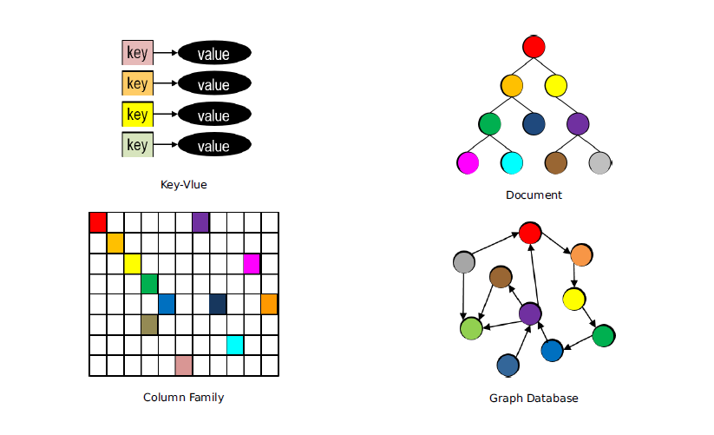

Slide 4
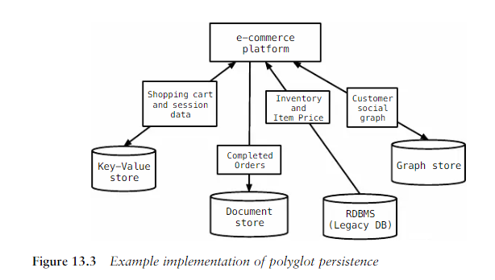
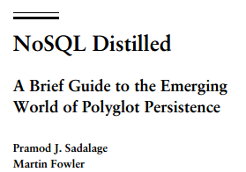

Slide 5
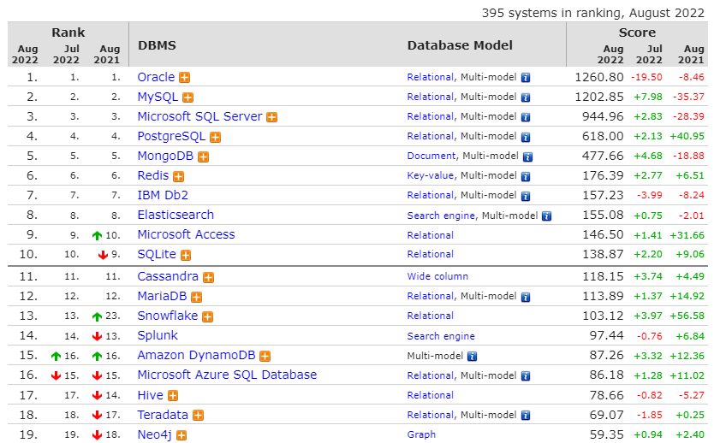
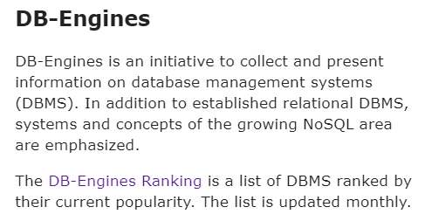

Slide 6
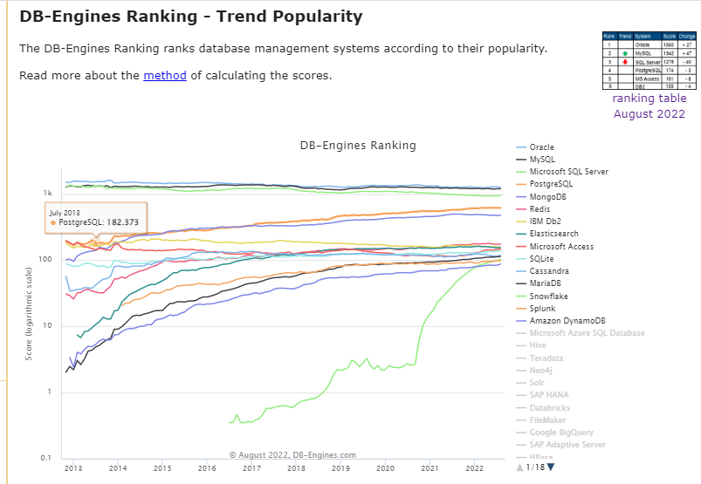

Slide 7
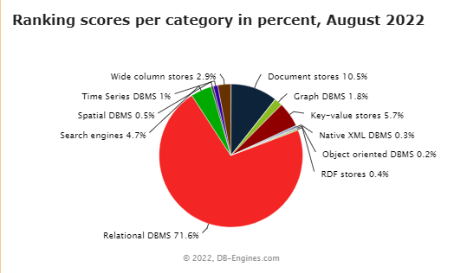

Slide 8
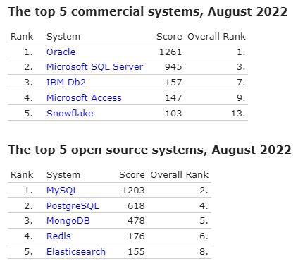
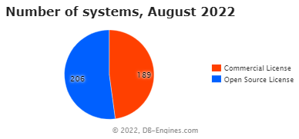
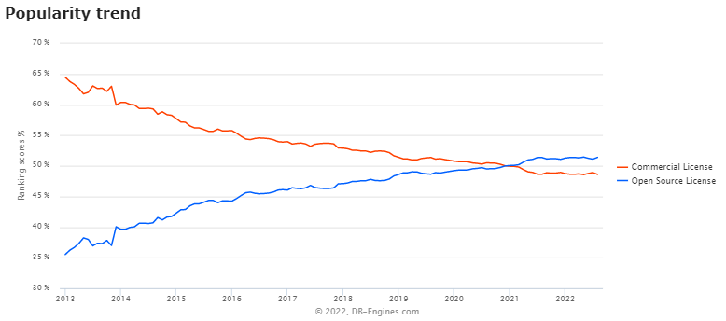

Slide 9
Catálogo de bases de datos
https://dbdb.io/

Slide 10
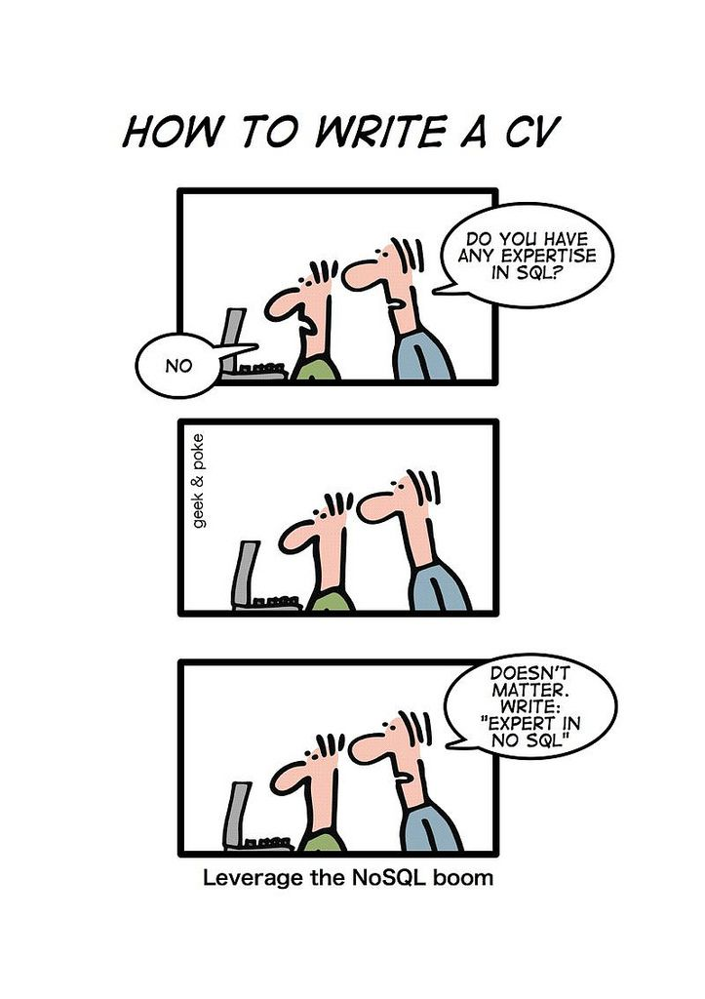

Slide 11
Scaling horizontally relational databases is a challenging task, if not impossible.
One of the main problems that a NoSQL databases solves is scale, among others.

Slide 12
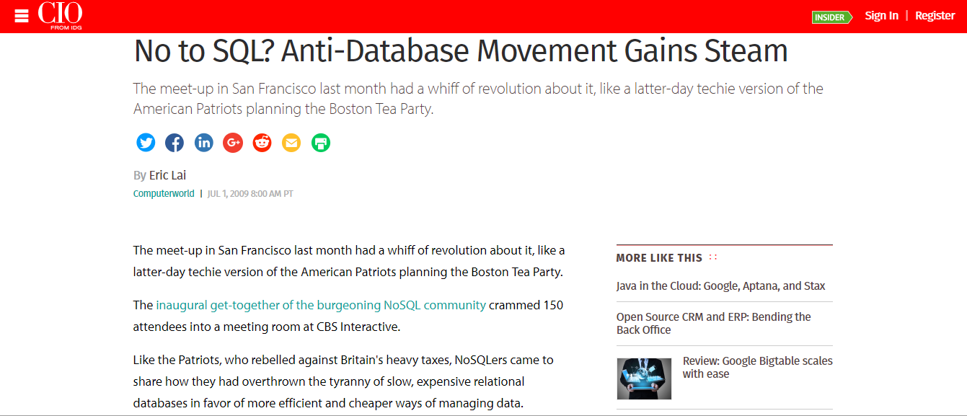

Slide 13
NoSQL originally started off as a simple combination of two words—No and SQL—clearly and completely visible in the new term. No acronym. What it literally means is, "I do not want to use SQL". To elaborate, "I want to access database without using any SQL syntax"
“…people are continually interpreting nosql to be anti-RDBMS, it's the only rational conclusion when the only thing some of these projects share in common is that they are not relational databases.”

Slide 14
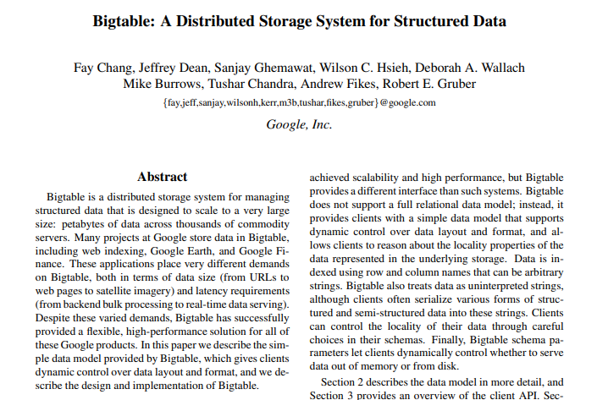
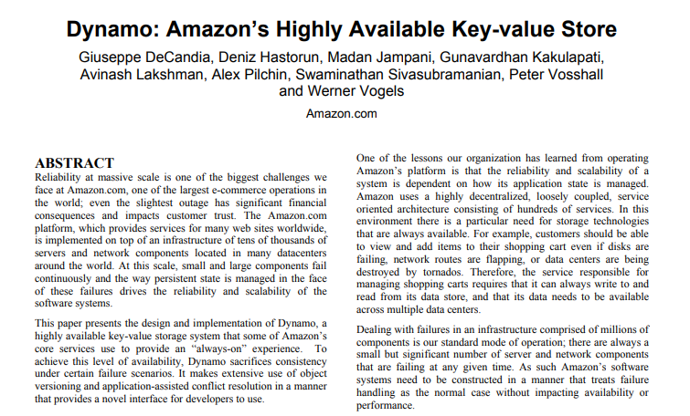
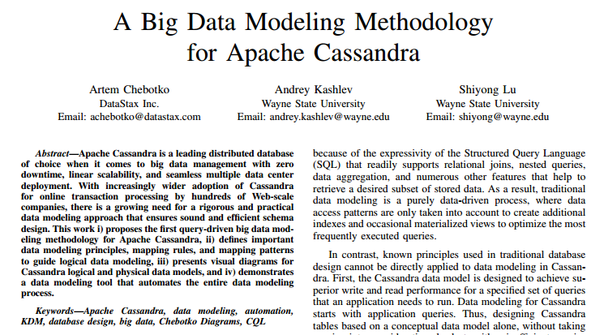
Hitos
Bigtable, 2006
Amazon, Dynamo, 2007
Facebook release Cassandra, 2008
Netflix, from Oracle to Cassandra, 2011

Slide 15
Bigtable, 2006
Column family
indexed by a row key, column key, and a timestamp
Amazon, Dynamo, 2007
Key value
Facebook release Cassandra, 2008
Column family

Slide 17
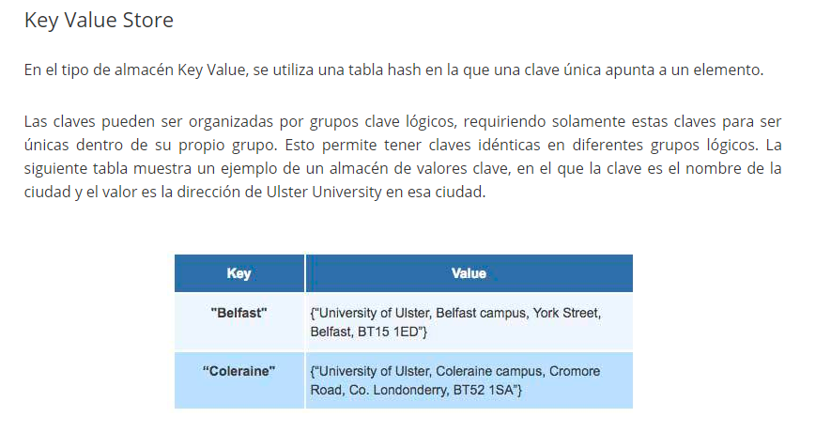
I

Slide 18
{
"EmployeeID": "SM1",
"FirstName" : "Anuj",
"LastName" : "Sharma",
"Age" : 45,
"Salary" : 10000000
}
{
"EmployeeID": "MM2",
"FirstName" : "Anand",
"Age" : 34,
"Salary" : 5000000,
"Address" : {
"Line1" : "123, 4th Street",
"City" : "Bangalore",
"State" : "Karnataka"
},
"Projects" : [
"nosql-migration",
"top-secret-007"
]
}
{
"LocationID" : "Bangalore-SDC-BTP-CVRN",
"RegisteredName" : "ACME Software Development Ltd"
"RegisteredAddress" : {
"Line1" : "123, 4th Street",
"City" : "Bangalore",
"State" : "Karnataka"
},
}
Document store
Most of the databases available under this category use XML or JSON. It is semi-structured as compared to rigid RDBMS.
For example, two records may have completely different set of fields or columns.
The records may or may not adhere to a specific schema (like the table definitions
in RDBMS). For that matter, the database may not support a schema or validating
a document against the schema at all.
(examples of document content using JSON)

Slide 19
Column Family

Slide 20
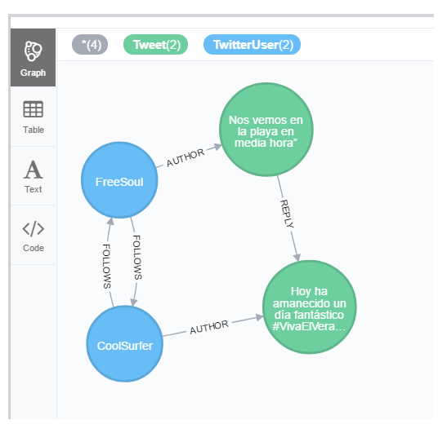
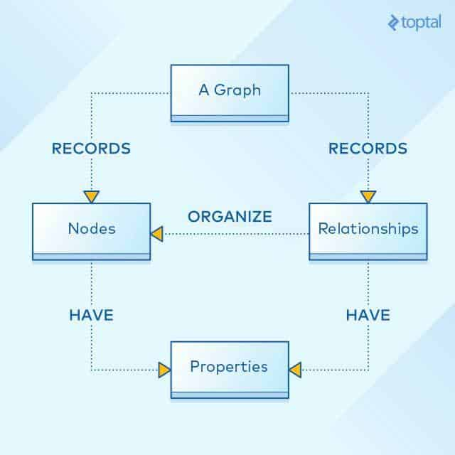
GRAFOS
Notes:
12

Slide 21
List of some of the mature, popular and powerful NoSQL databases
Notes:
12

Slide 22
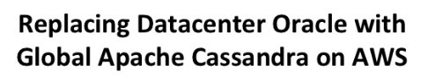
ROOPA TANGIRALA
Engineering Manager
Netflix
Notes:
Lot of questions on how Netflix migrated Want to share the story so that you all can take away from our journey and do your own big leaps !

Slide 23

1997
Netflix was originally nothing more than an online version of a traditional video rental store. Customers could visit the Netflix website and choose which items they wished to rent. Each rental cost $4, along with a $2 shipping fee.
2007 Netflix shipped its billionth DVD!

Slide 24
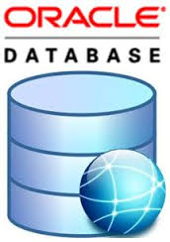


BACKEND
RDBMS not flexible enough to handle modern day applications, which are a mixture of structured, semi-structured and unstructured data. WHILE Oracle handles structured data well it lacks dynamic datamodel which is important for high traffic modern applications.
Notes:
Backend for transactional datasets, this does not include the reporting or the Business analytics part of it.

Slide 25
NO HORIZONTAL SCALING
Oracle scales up , master slave design limits both its scalability and performance for online applications, the failure of Oracle to add more capacity online in an elastic fashion without impacting the applications is a major drawback.
Notes:
Oracle scales up , master slave design limits both its scalability and performance for online applications, the failure of Oracle to add more capacity online in an elastic fashion without impacting the applications is a major drawback. IBM power 7 , 32 dual core 64 bit multiprocessors, 750GB RAM, TB’s storage allocated via SVC MCS cluster which is 8G4 cluster with 4GB/sec interface running with RAID 10 configurations.

Slide 26
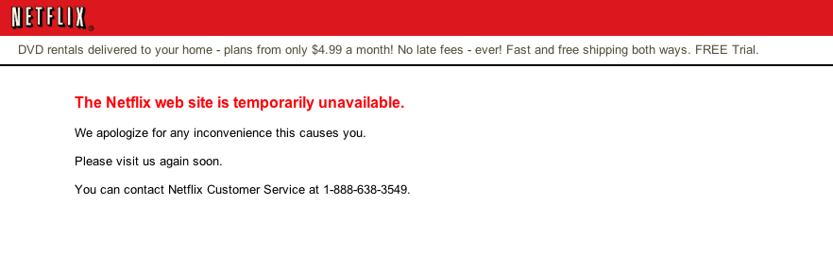
EVERY TWO WEEKS!!
Website went down every two weeks to include changes to PLSQL procedures, packages, schema changes and other backend database changes. Was ok for DVD since the shipping could happen after the site was back up but not acceptable for streaming service.
Notes:
Website went down every two weeks to include changes to PLSQL procedures, packages, schema changes and other backend database changes. Was ok for DVD since the shipping could happen after the site was back up but not acceptable for streaming service.

Slide 27
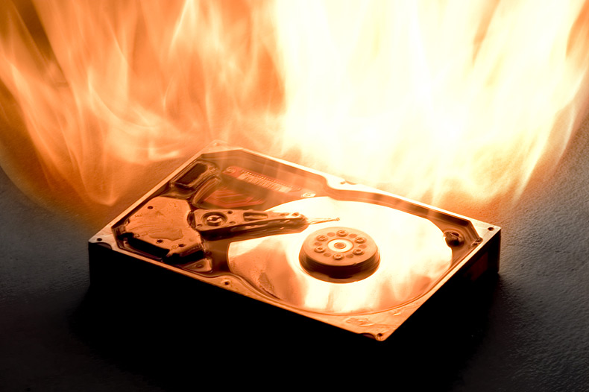
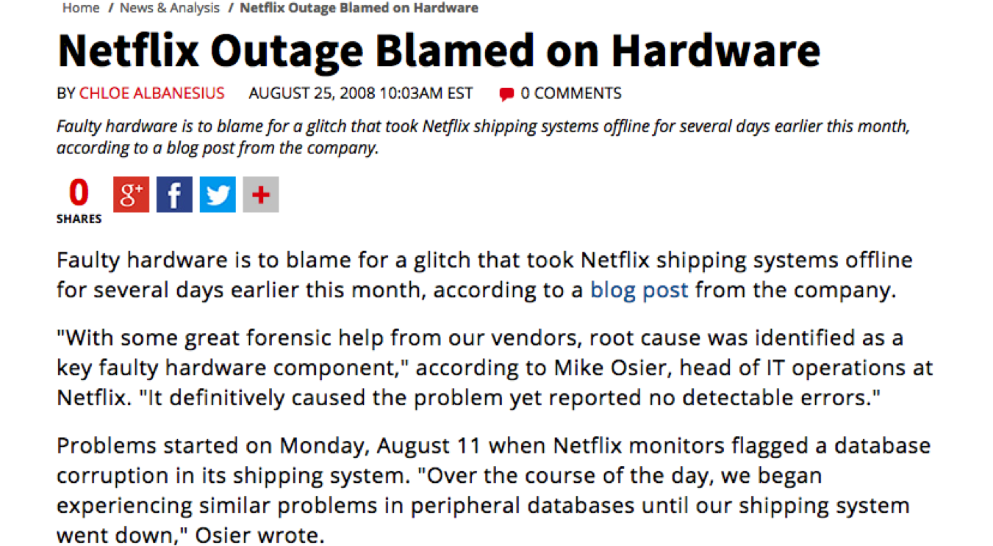
2008
This was the ugly outage and changed the way they think about infrastructure , reliability and availability.
Notes:
This was the ugly outage and changed the way we think about infrastructure , reliability and availability.

Slide 28

MOVE TO CLOUD
Notes:
1. Re-architect – question everything including keeping our own DC
2. Letting AWS focus on DC allows our engineers to focus on building and improving our business
3. Ideal for horizontal scaling architecture – even if we are not able to predict the customer growth
4. Cloud computing is the future.

Slide 29


REQUIREMENTS
HIGHLY AVAILABLE
MULTI DATACENTER SUPPORT
PREDICTABLE PERFORMANCE AT SCALE

Slide 30
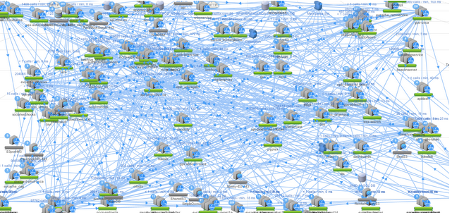
Horizontal, Homogenous, Commoditized

Slide 31

SECURITY
CHALLENGES
DENORMALIZE
DENORMALIZE
DENORMALIZE
DENORMALIZE
DENORMALIZE

Slide 32
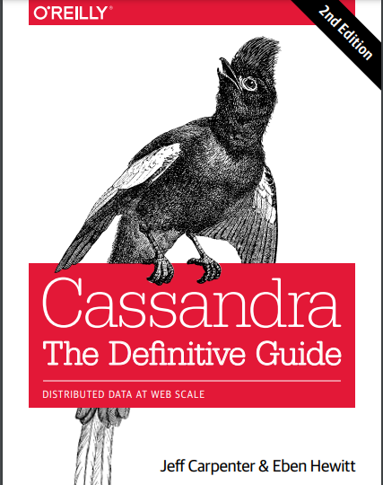

Slide 33
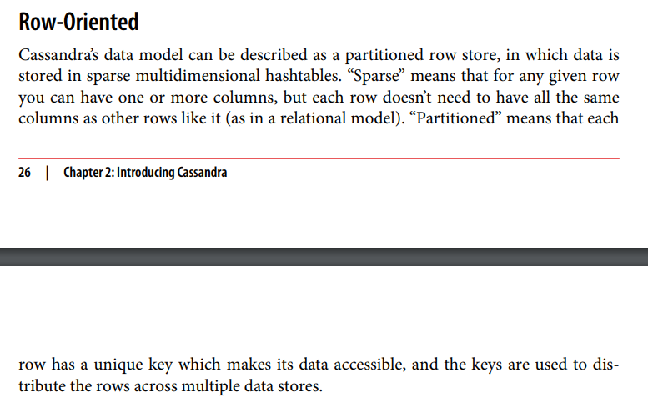

Slide 34
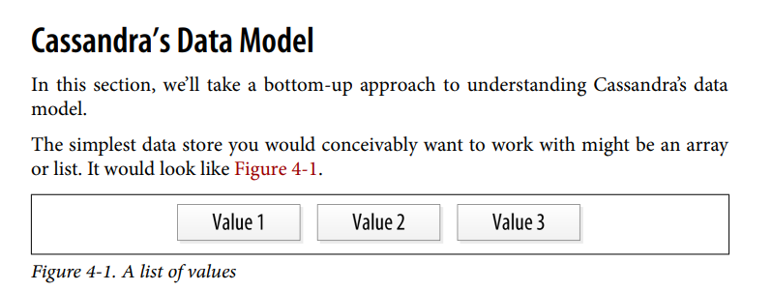
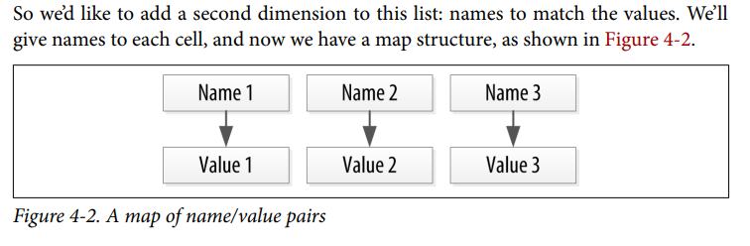

Slide 35
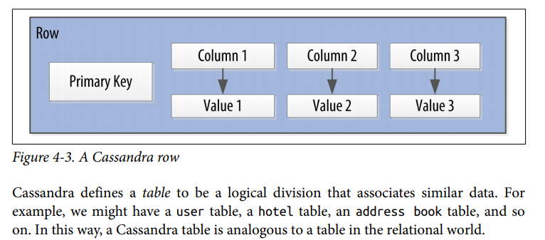
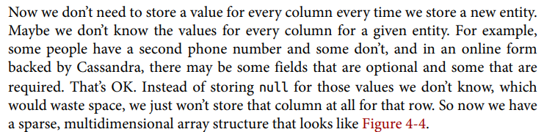

Slide 36
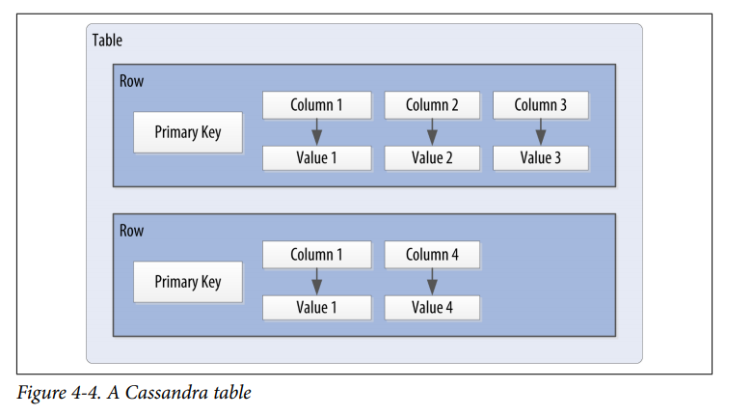
 | Column 1 | Column 2 | Column 3 | Column 4
Row 1 | Value 1 | Value 2 | Value 3
Row 2 | Value 1 |  |  | Value 4

Slide 37
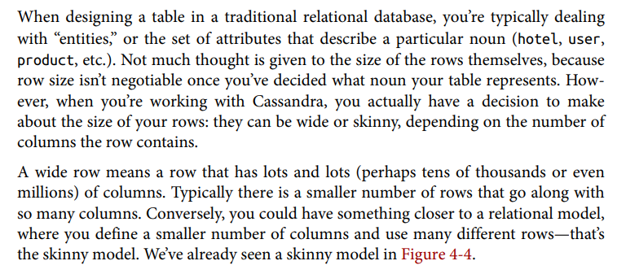

Slide 38
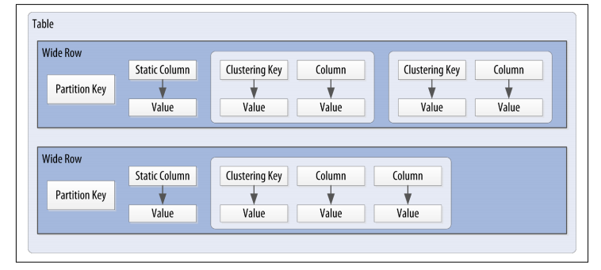
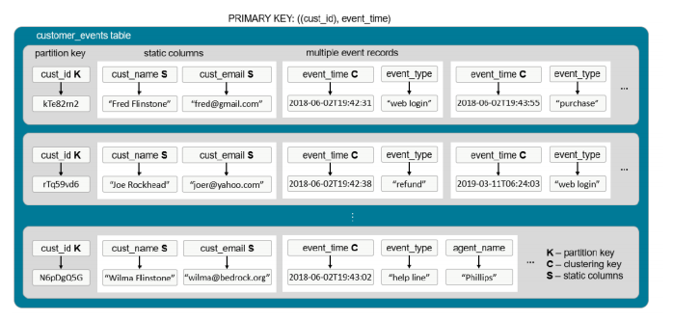

Slide 39
CONSISTENCIA

Slide 40
Modelos de consistencia: determina la visibilidad y el orden aparente de las actualizaciones.
Es básicamente un contrato entre los procesos y el almacén de datos. Este contrato dice que, si los procesos aceptan obedecer ciertas reglas, el almacén promete funcionar correctamente.

Slide 41
Consistencia fuerte: todas las operaciones de lectura deben devolver datos de la última operación de escritura completada.
Consistencia eventual: las operaciones de lectura verán, conforme pasa el tiempo, las escrituras. En un estado de equilibrio, el estado devolvería el último valor escrito.
A medida que
t ∞
los clientes verán las escrituras

Slide 42
Consistencia no estricta
Read Your Own Writes (RYOW) consistency
El cliente lees sus actualizaciones inmediatamente después de que hayan sido completadas, independientemente si escribe en un server y lee de otro. Las actualizaciones de otros clientes no tienen por qué ser visibles instantáneamente.

Slide 43
Consistencia no estricta
Consistencia de sesión
Un poco más débil que RYOW. Provee ésta consistencia solo si el cliente está dentro de la misma sesión. Usualmente sobre el mismo server.

Slide 44
Consistencia no estricta
Consistencia eventual

Slide 45
Teorema CAP
Consistency todos ven los mismos datos al mismo tiempo
Availability si se puede comunicar con un nodo en el cluster, entonces se pueden leer y escribir datos
Partition tolerance el cluster puede sobrevivir a roturas de comunicación que lo dividan en particiones que no pueden comunicarse entre ellas
Es imposible para cualquier sistema de computación distribuida proveer las tres propiedades simultáneamente.

Slide 46
Las 8 Falacias de la Computación Distribuida
1. La red es confiable
2. La latencia es cero; la latencia no es problema
3. El ancho de banda es infinito
4. La red es segura
5. La topología no cambia
6. Hay uno y solo un administrador
7. El coste de transporte es cero
8. La red es homogénea

Slide 47
Teorema CAP
Las 8 Falacias de la Computación Distribuida
Consistency
Availability
Partition tolerance

Slide 48
Teorema CAP
Las 8 Falacias de la Computación Distribuida
¡Hay que tolerar particiones!
CP - Consistency/Partition Tolerance
AP - Availability/Partition Tolerance

Slide 49
Ejemplo
Las transacciones bancarias son inconsistentes, particularmente para ATMs, que están diseñados para tener un comportamiento en modo normal y otro en modo partición. En modo partición la Availability es elegida por sobre la Consistencia
Históricamente la industria financiera ha sido inconsistente a causa de la imperfección de las comunicaciones.

Slide 50
ATMs realizan operaciones conmutativas de manera que el orden en el cuales se aplican no importa.
Si hay una partición el cajero puede seguir funcionando; luego al volver a recuperar la partición se envían las operaciones y el saldo final sigue siendo correcto.
Lo que se hace es delimitar y administrar el riesgo. Los ATMs son rentables aún a costa de alguna pérdida.

Slide 51
Traditional RDBMS applications have focused on ACID transactions:
• Atomicity: Everything in a transaction succeeds lest it is rolled back.
• Consistency: A transaction cannot leave the database in an inconsistent state.
• Isolation: One transaction cannot interfere with another.
• Durability: A completed transaction persists, even after applications restart.

Slide 52
BASE, coined by Eric Brewer:
• Basic availability: Each request is guaranteed a response—successful or failed execution.
• Soft state: The state of the system may change over time, at times without any input (for eventual consistency).
• Eventual consistency: The database may be momentarily inconsistent but will be consistent eventually.

Slide 54
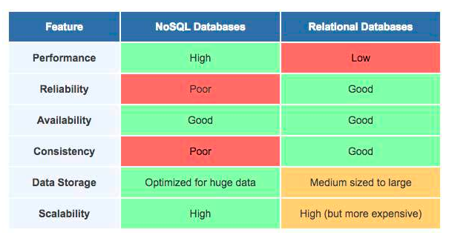

Slide 55
SQL vs NOSQL vs NEWSQL: FINDING THE RIGHT SOLUTION

Slide 56
OLDSQL
Traditional SQL databases have been around for decades and serve as the core foundation of nearly every application we use today.
THE OLDSQL ADVANTAGES
An established market and ecosystem with vast amounts of standards-based tooling.
THE OLDSQL DISADVANTAGES
They are good for general purpose applications with modest performance requirements, but struggle as needs grow.

Slide 57
NOSQL
SOME NOSQL SYSTEMS PUT AVAILABILITY FIRST
SOME NOSQL SYSTEMS FOCUS ON FLEXIBILITY
SOME NOSQL SYSTEMS FOCUS ON ALTERNATIVE DATA MODELS OR SPECIAL USE CASES
THE NOSQL ADVANTAGES
Highest availability across multiple data centers
THE NOSQL DISADVANTAGES
These systems are fundamentally not transactional (ACID)

Slide 58
NEWSQL
NewSQL systems all start with the relational data model and the SQL query language, and they all try to address some of the same sorts of scalability, inflexibility or lack-of-focus that has driven the NoSQL movement. Many offer stronger consistency guarantees.
THE NEED FOR SPEED: FAST IN-MEMORY SQL
THE NEWSQL ADVANTAGES:
Many systems offer NoSQL-style clustering with more traditional data and query models
THE NEWSQL DISADVANTAGES
Offers only partial access to the rich tooling of traditional SQL systems

